Slide 1
Maven Java project in Eclipse
Experiment 1: Create a Maven java project in Eclipse
Open eclipse and follow the following steps
Step 1: Go to File, click on NEW, and then on tab others in pop-down menu
Step 2: In the select wizard, select Maven Project and press Next
Step 3: Note internet is present, and in Use default Workspace location path is present and with a clicked check box. Then press Next
Step 4: At Filter: type org.apache.maven, to get org.apache.maven.archetype maven-archetype-quickstart 1.4 in the below list. Select it and press Next
Step 5: Enter any name at Group Id, Artifact Id but must be different for all projects. Then press Finish Note: given here Group Id = SEGroup and Artifact Id = MavenJavaProject
Step 6: See in Project Explorer, a project with the same Artifact Id created (eg MavenJavaProject. Content of App.java with This is the first Maven Java Project in Eclipse given
Step 7: Now right-click on it then on Run As, and then click/Press on Maven Clean
Step 8: Maven clean used to clear previous output Now it should show BUILD SUCCESS, which means correct
Step 9: Again right-click on MavenJavaProject then on Run As, and then click/Press on Maven Install. To add artifact(s) the local repository

Slide 2
Continued….
Step 10: Now it should show BUILD SUCCESS, which means correct
Step 11: Again right-click on MavenJavaProject, then on Run As, and then click/Press on Maven Test
Step 12: Maven Test used to specify test classes or methods we want to execute Now it should show BUILD SUCCESS, which means correct
Step 13: Again right-click on MavenJavaProject, then on Run As, and then click/Press on Maven BUILD. Compiles source code of the project, Creates JAR or WAR file for the project to convert it into a distributable format.
Step 14: Next it shows the Edit Configuration window as below. Set Goals to clean install test or package. Then press on Apply, and then on Run
Step 15: Maven Java project built successfully
Step 16: select Run AS then on Java Application
Step 17: select App- SEGroup.MAvenJavaProject and click on OK
Step 18: The output “This is the first Java Project in Eclipse” is displayed

Slide 3
Experiment 2: Push Maven java project to github directory
Step 19: Go to Github, and create an empty repository to get the Maven Java Project. Give Repository name =
MavenJavaProject, select Public, tick on Add README, select gitignore template maven , to ignore unwanted
target files in maven project while committing
Step 20: Press on create repository
Step 21: Go to Eclipse, right-click on MavenJavaProject, Properties , Resourses to get the path
Step 22: Copy the path of the eclipse workspace
Step 23: Go to Git bash, and Change the directory to eclipse workspace, and then to MavenJavaProject. Next
It must show pom.xml
Step 24: git init and git add to initialize and add to the local repository
Step 25: git commit in local repository
Step 26: Go to Git Hub and get the remote repository path
Step 27: get a remote repository and push
Step 28: Go to git Hub after pushing from git bash. Now refresh the git hub we see all the files are reflected here

Slide 4
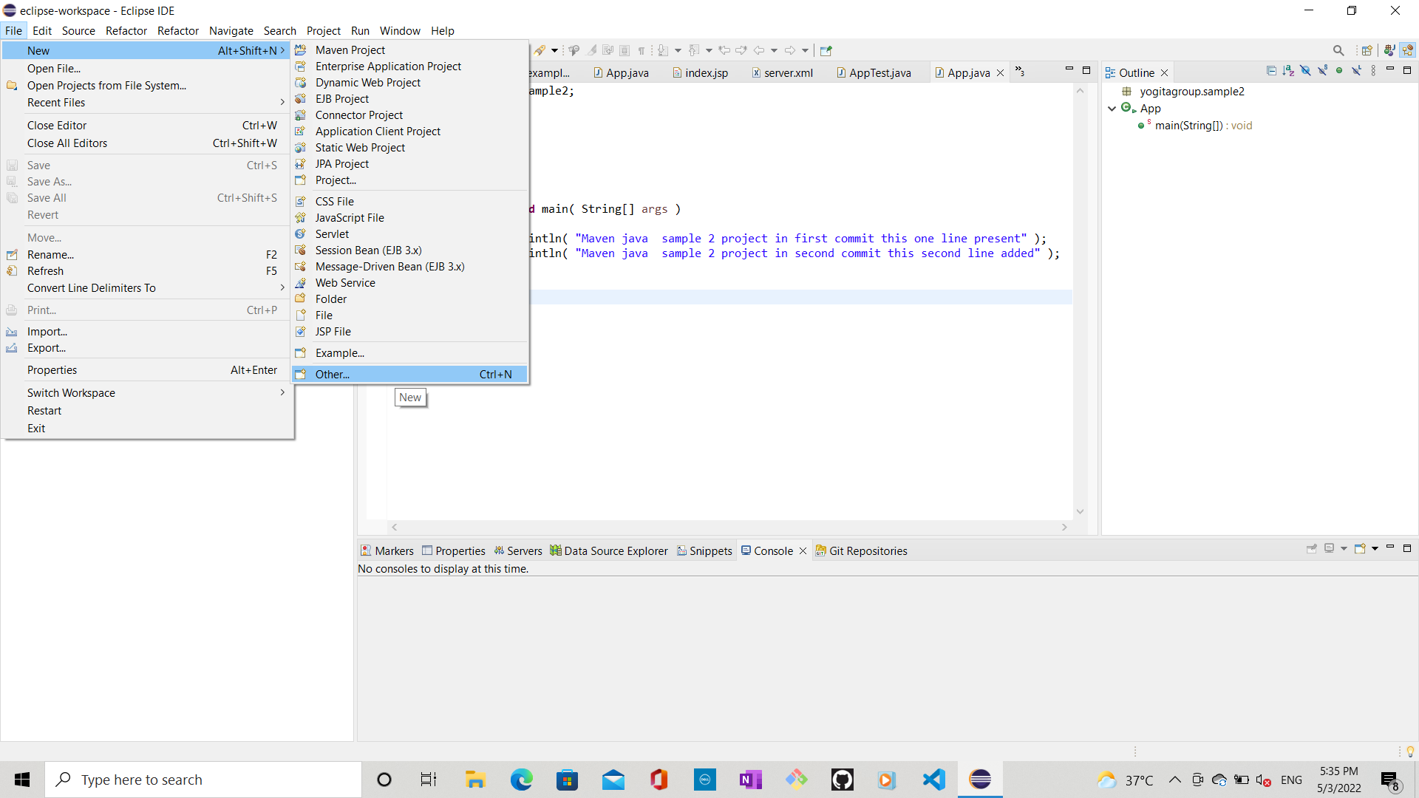
Step 1: Go to File, click on NEW and then on tab others in pop down menu

Slide 5
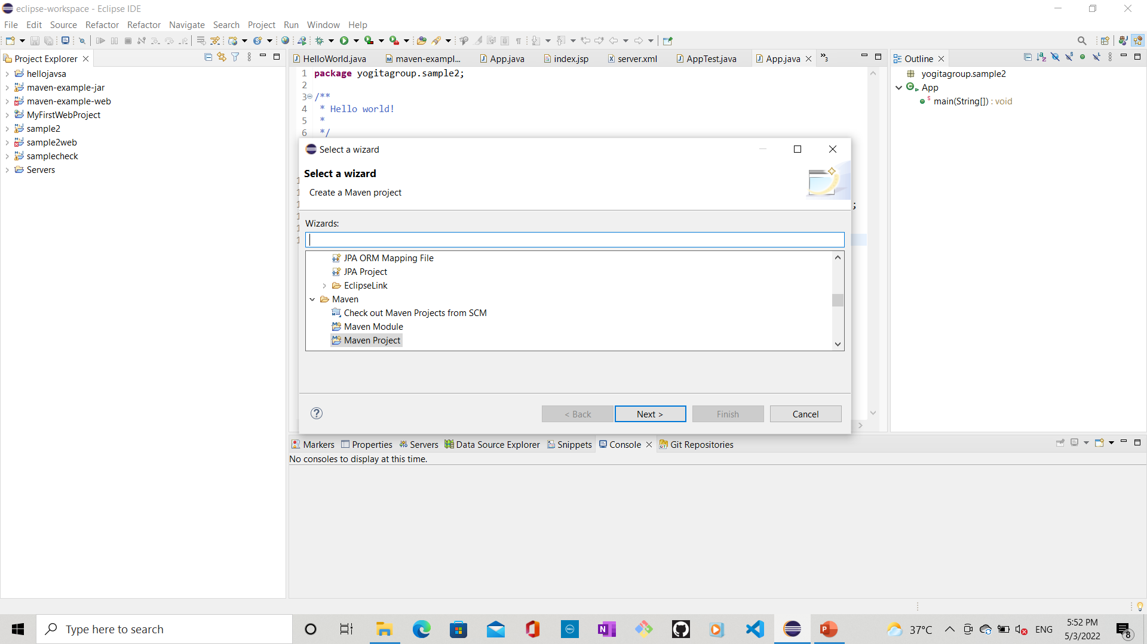
Step 2: In the select wizard, select Maven Project and press Next

Slide 6
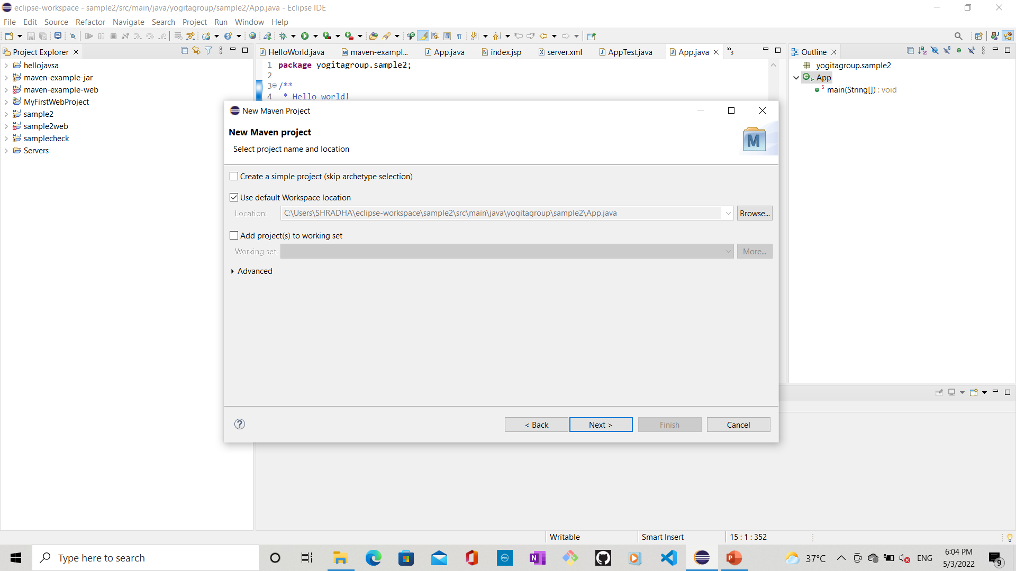
Step 3: Note internet is present, and in Use default Workspace location path is present and with a clicked check box. Then press Next

Slide 7
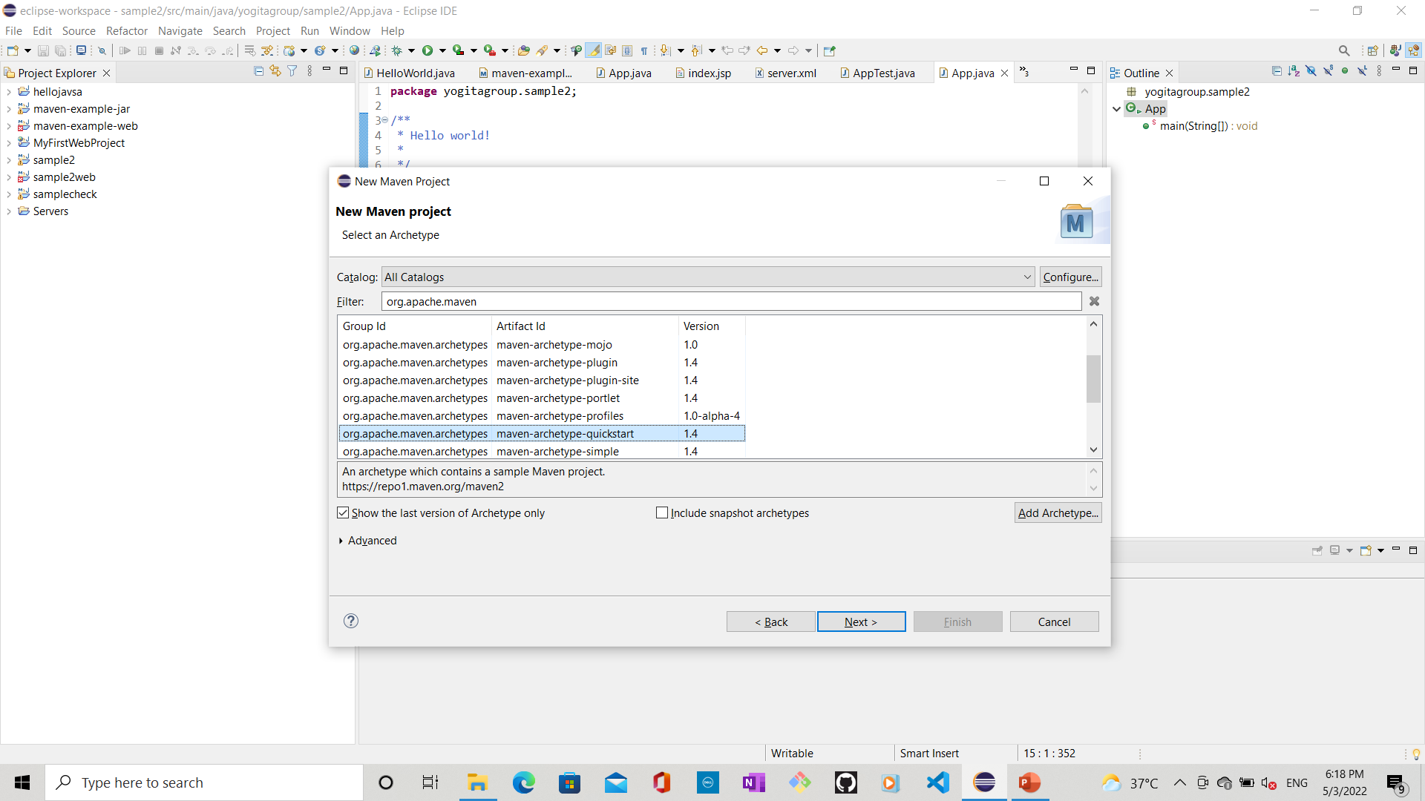
Step 4: At Filter: type org.apache.maven, to get org.apache.maven.archetype maven-archetype-quickstart 1.4 in below list. Select it and press Next

Slide 8
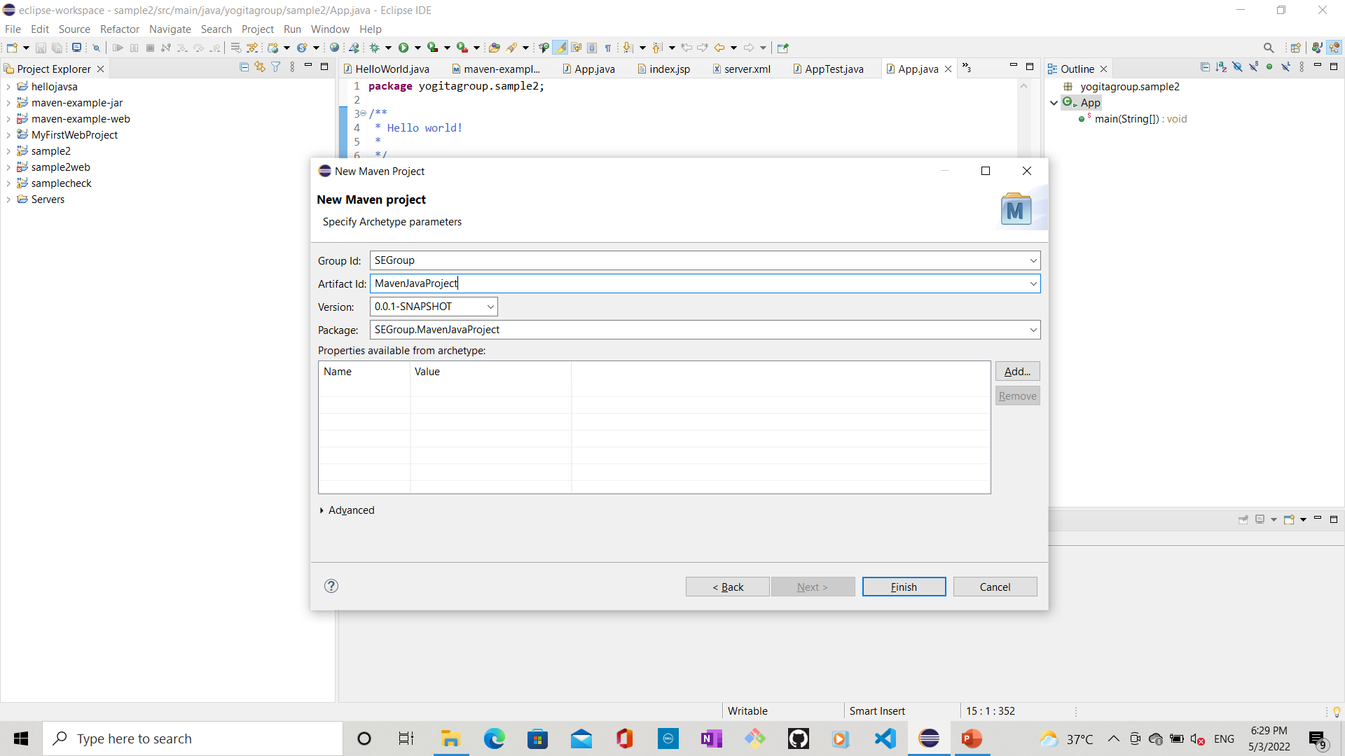
Step 5: Enter any name at Group Id, Artifact Id but must be different for all projects. Then press Finish Note: given here Group Id = SEGroup and Artifact Id = MavenJavaProject

Slide 9
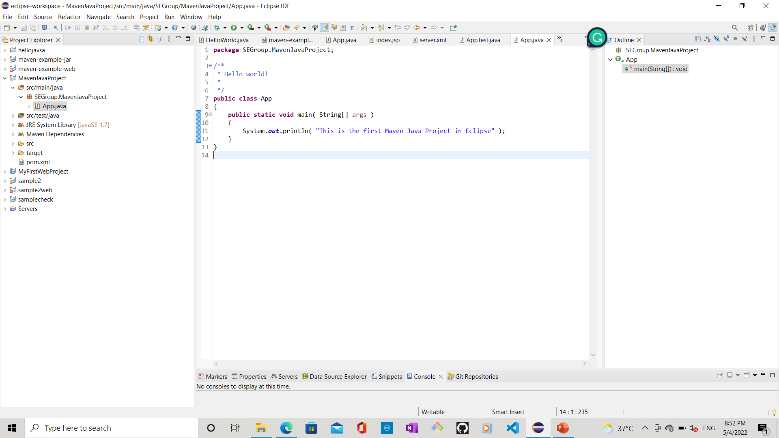
Step 6: See in Project Explorer, project with the same Artifact Id created (eg MavenJavaProject. Content of App.java with This is the first Maven Java Project in Eclipse given

Slide 10
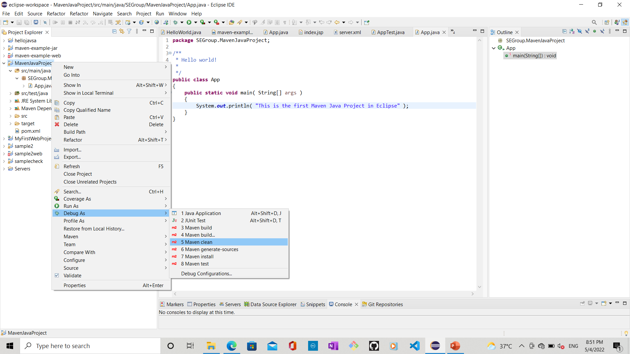
Step 7: Now right-click on it then on Run As, and then click/Press on Maven Clean

Slide 11
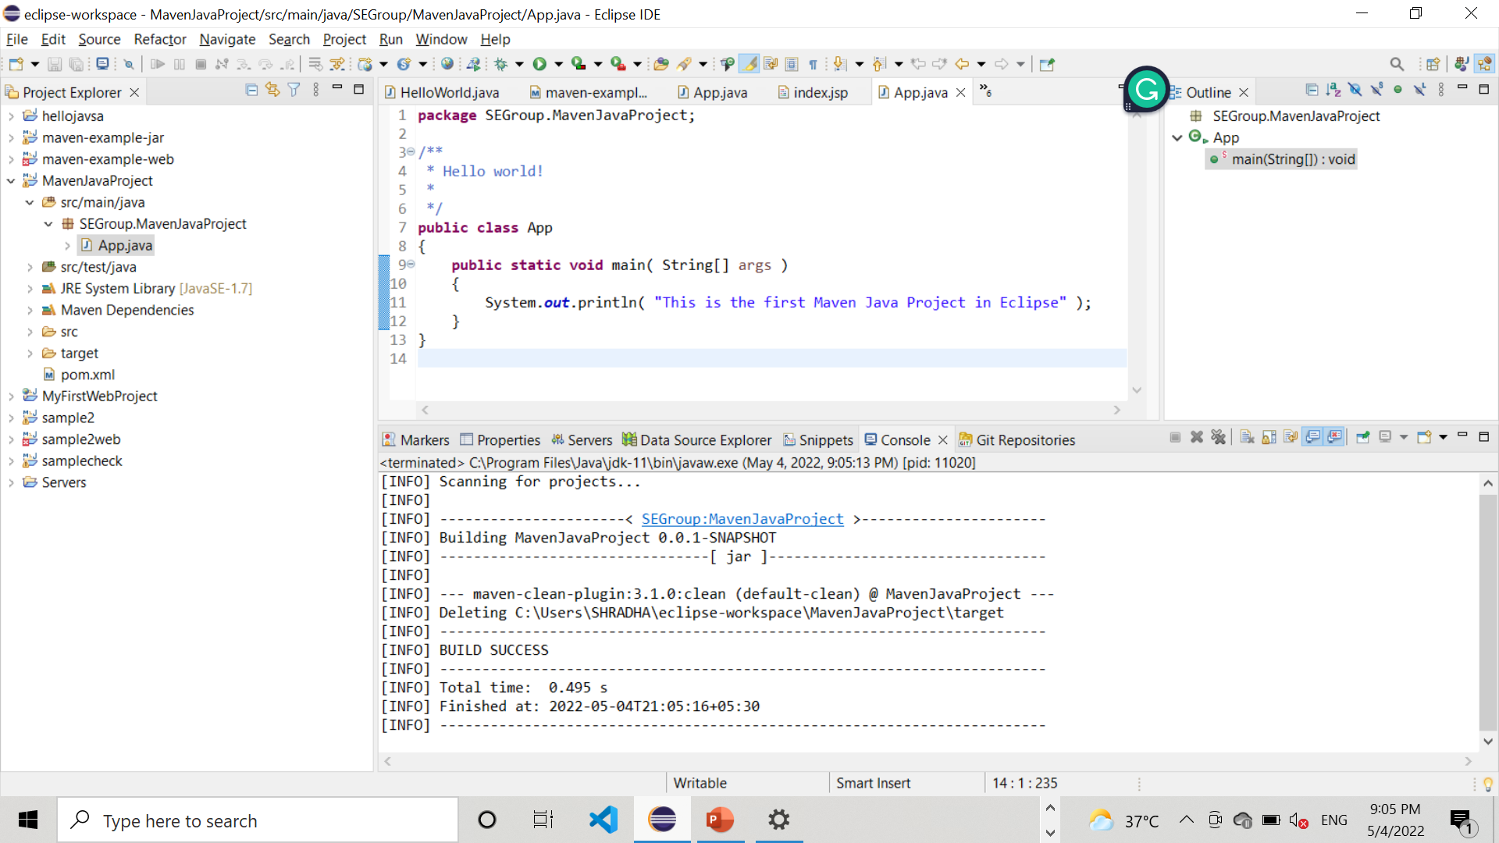
Step 8: Maven clean used to clear previous output Now it should show BUILD SUCCESS, which means correct

Slide 12
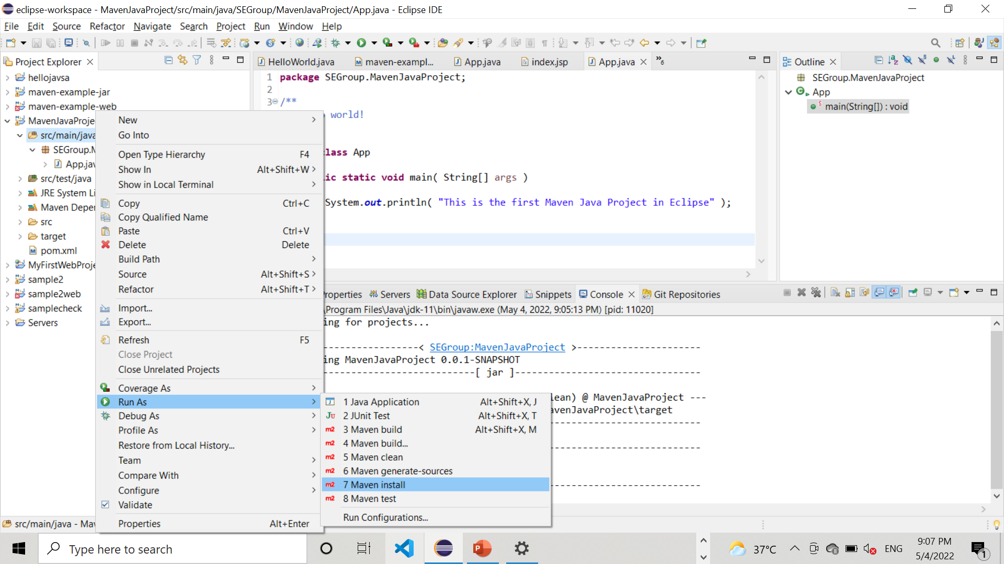
Step 9: Again right-click on MavenJavaProject then on Run As, and then click/Press on Maven Install

Slide 13
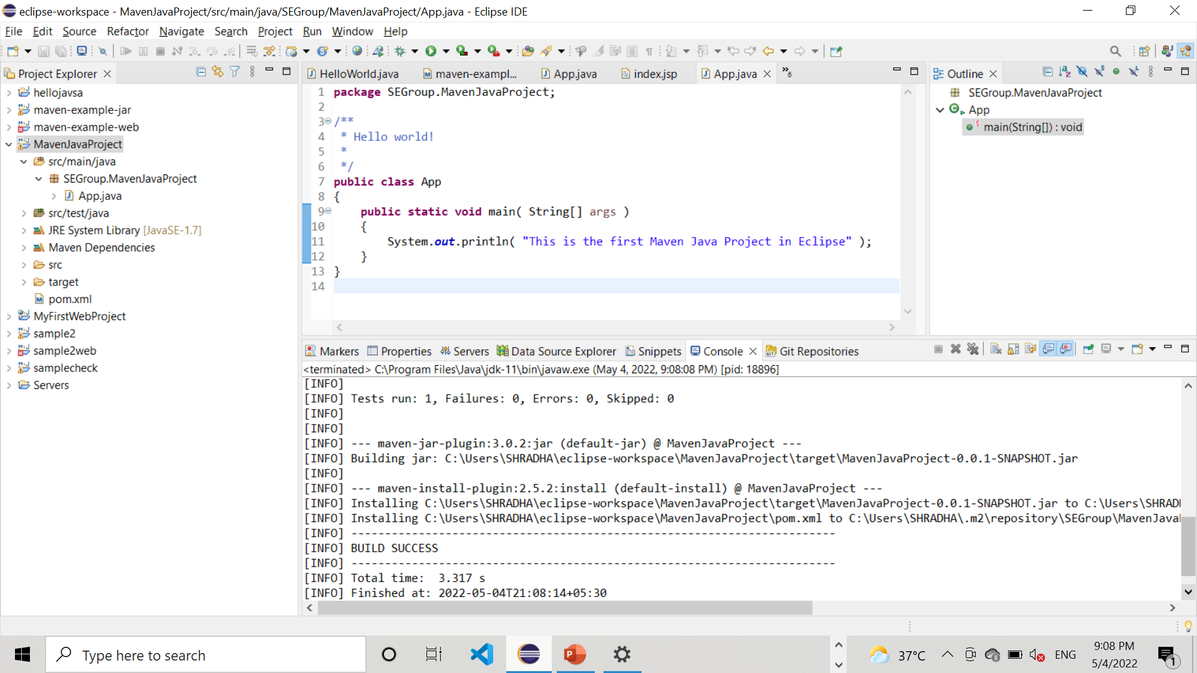
Step 10: Maven Install used to add Artifacts Now it should show BUILD SUCCESS, which means correct

Slide 14
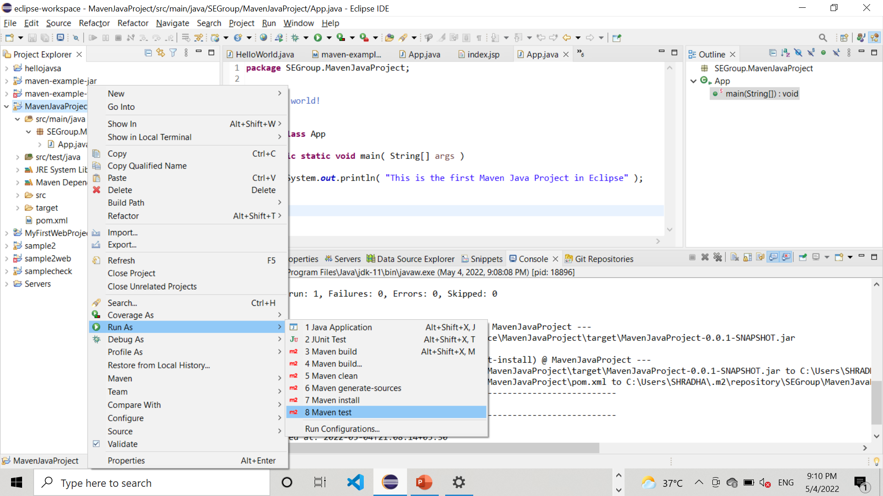
Step 11: Again right-click on MavenJavaProject, then on Run As, and then click/Press on Maven Test

Slide 15
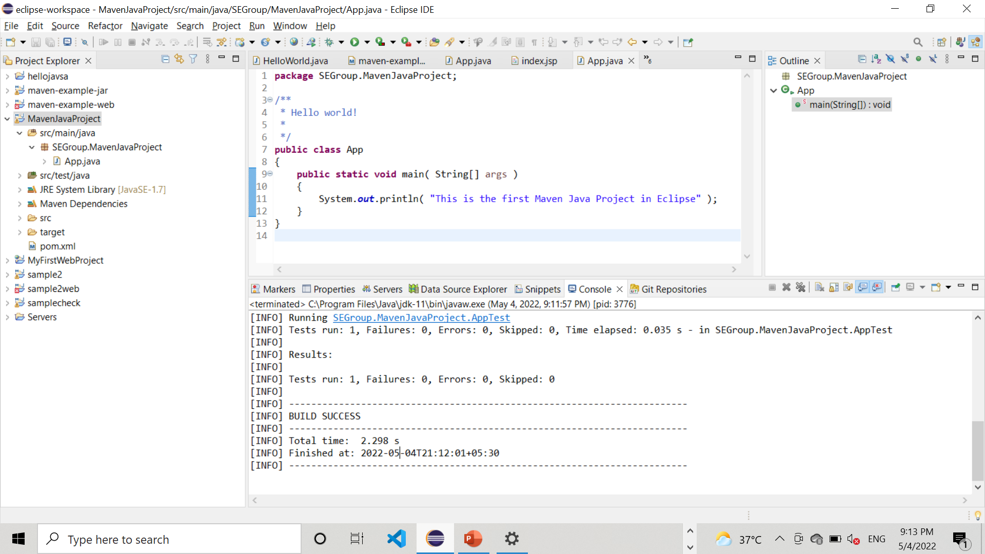
Step 12: Maven Test used to the code Now it should show BUILD SUCCESS, which means correct

Slide 16
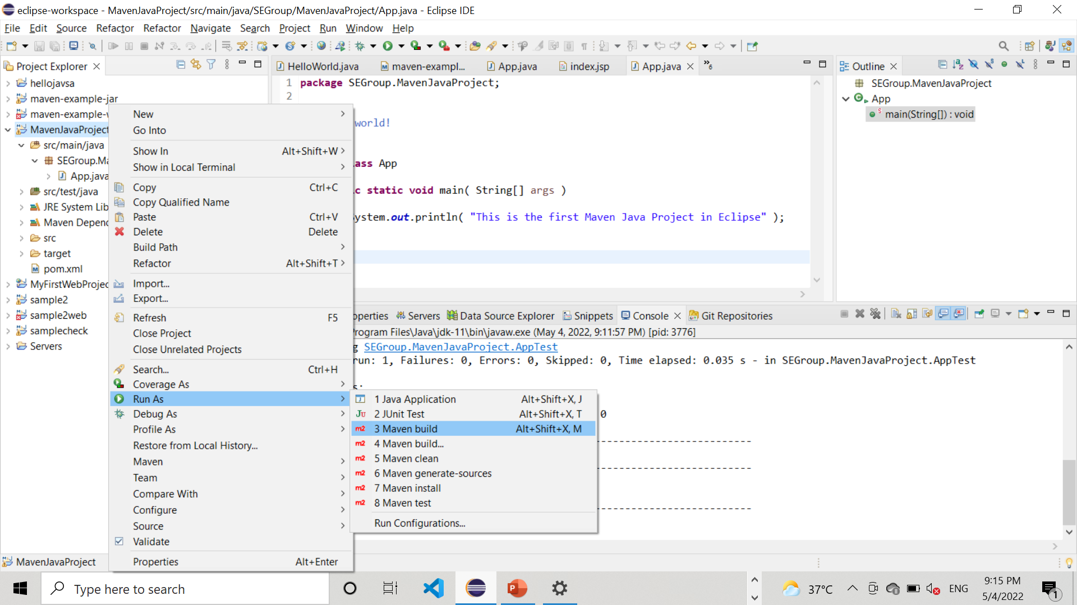
Step 13: Again right-click on MavenJavaProject, then on Run As, and then click/Press on Maven BUILD

Slide 17
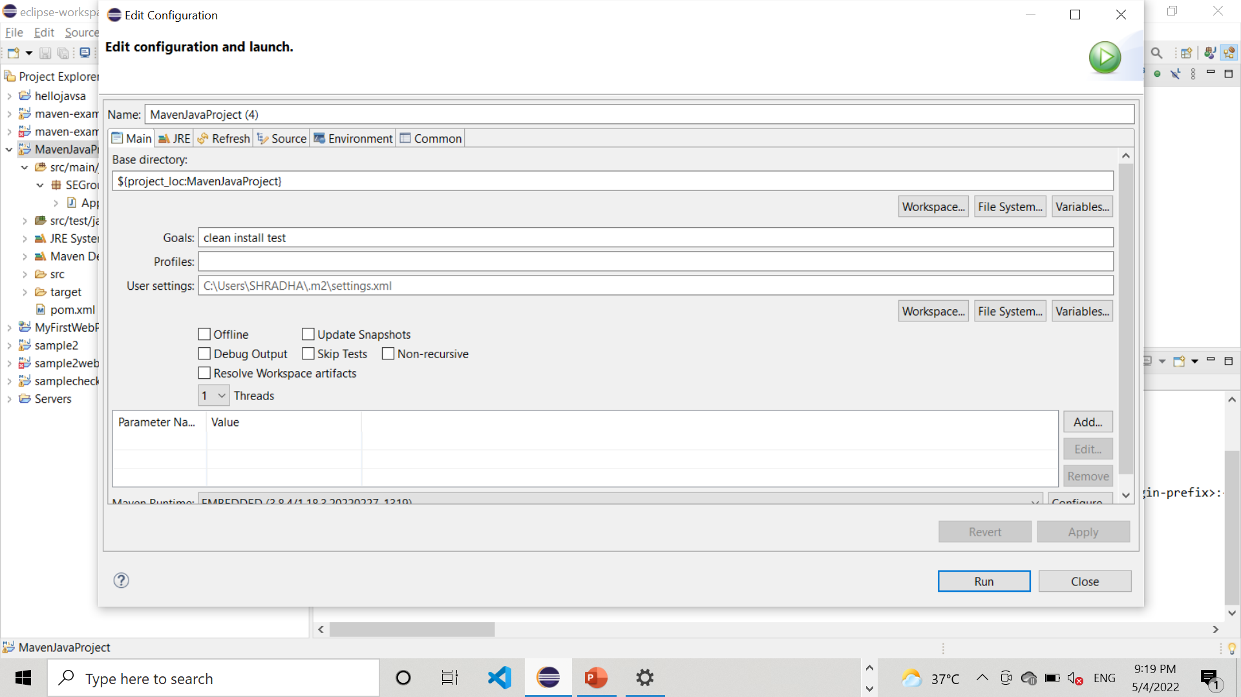
Step 14: Next it shows the Edit Configuration window as below. Set Goals to clean install test or package. Then press on Apply, and then on Run

Slide 18
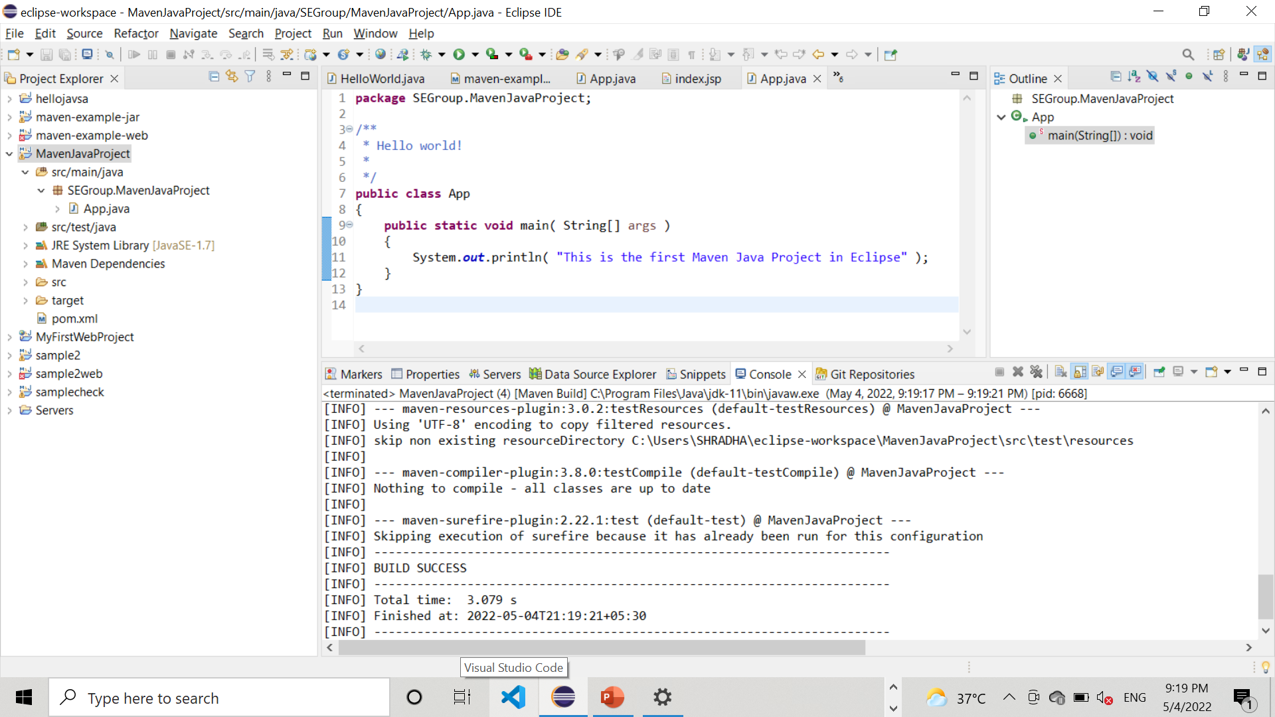
Step 15: Maven Java project built successfully

Slide 19
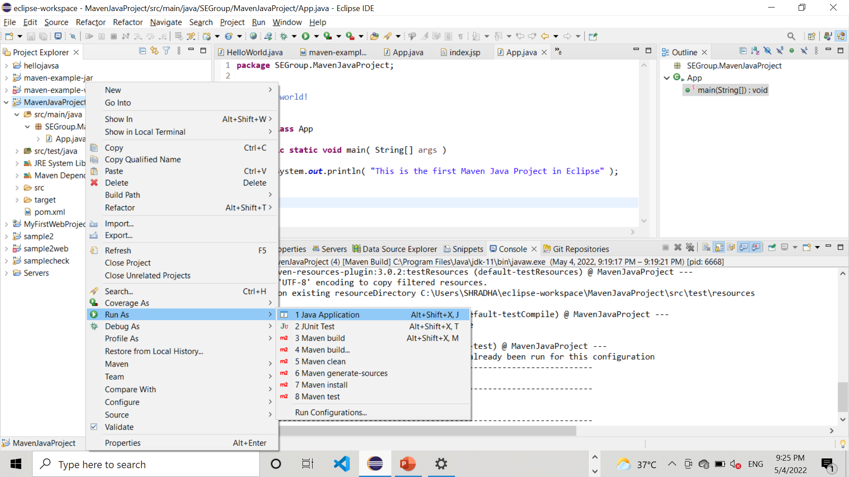
Step 16: select Run AS then on Java Application

Slide 20
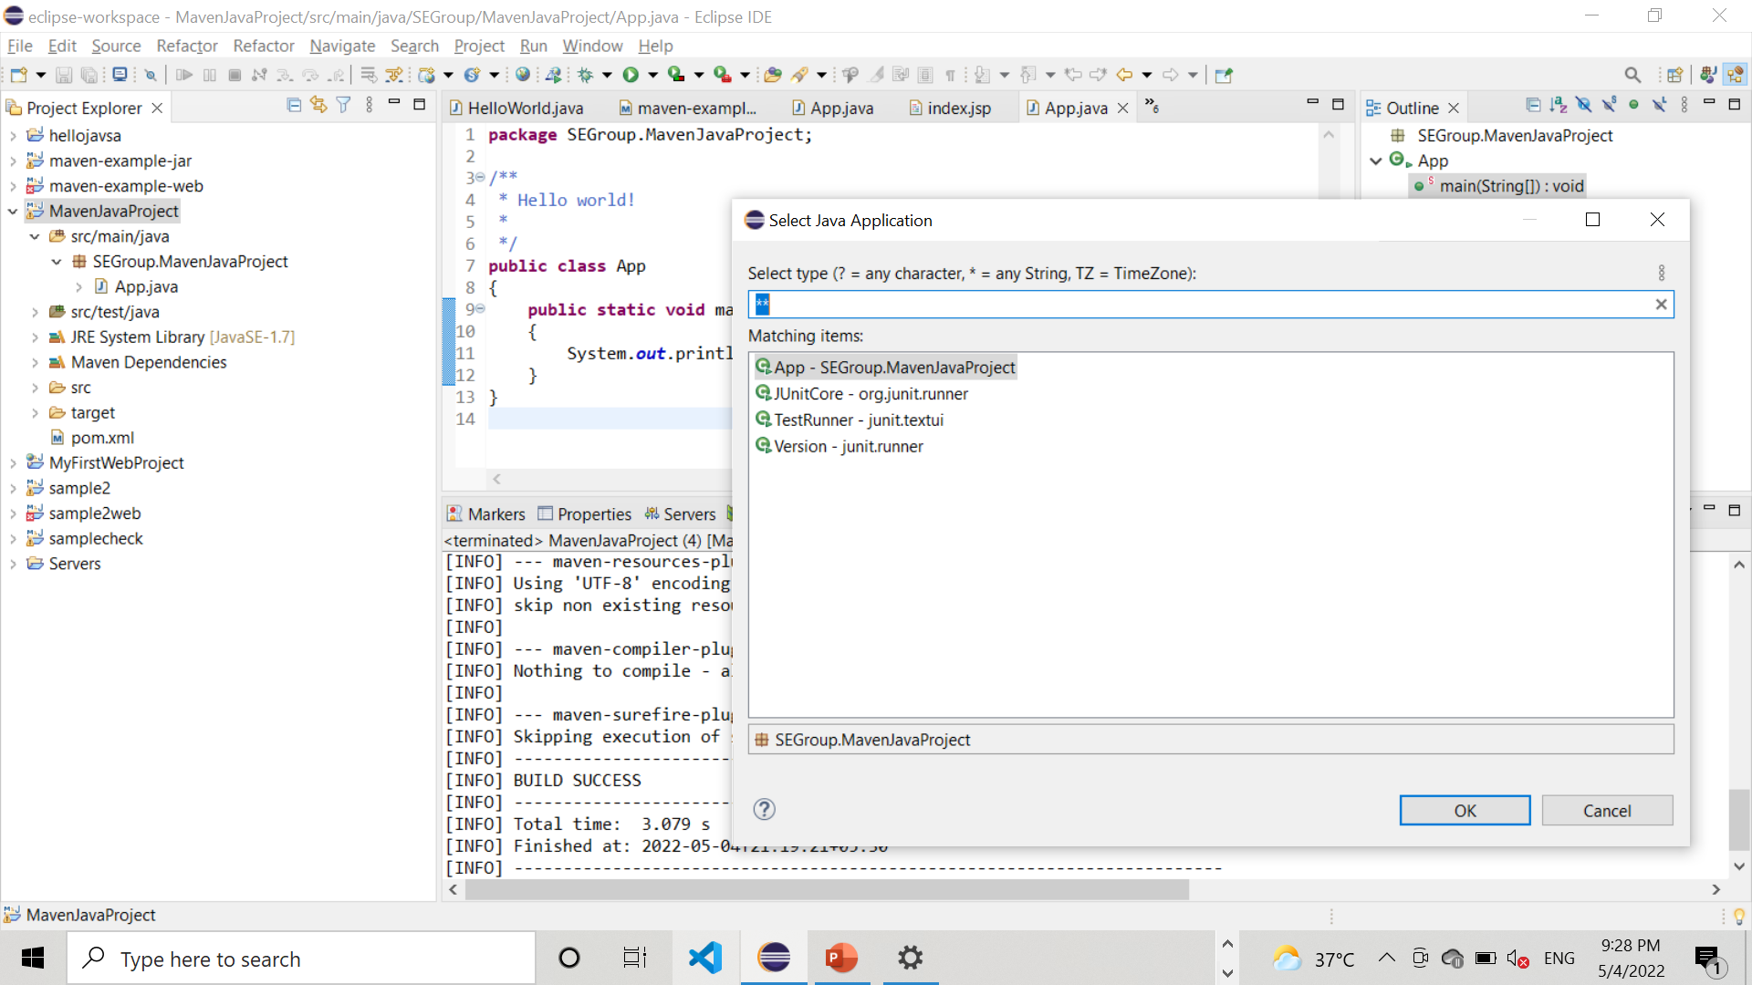
Step 17: select App- SEGroup.MAvenJavaProject on click on OK

Slide 21
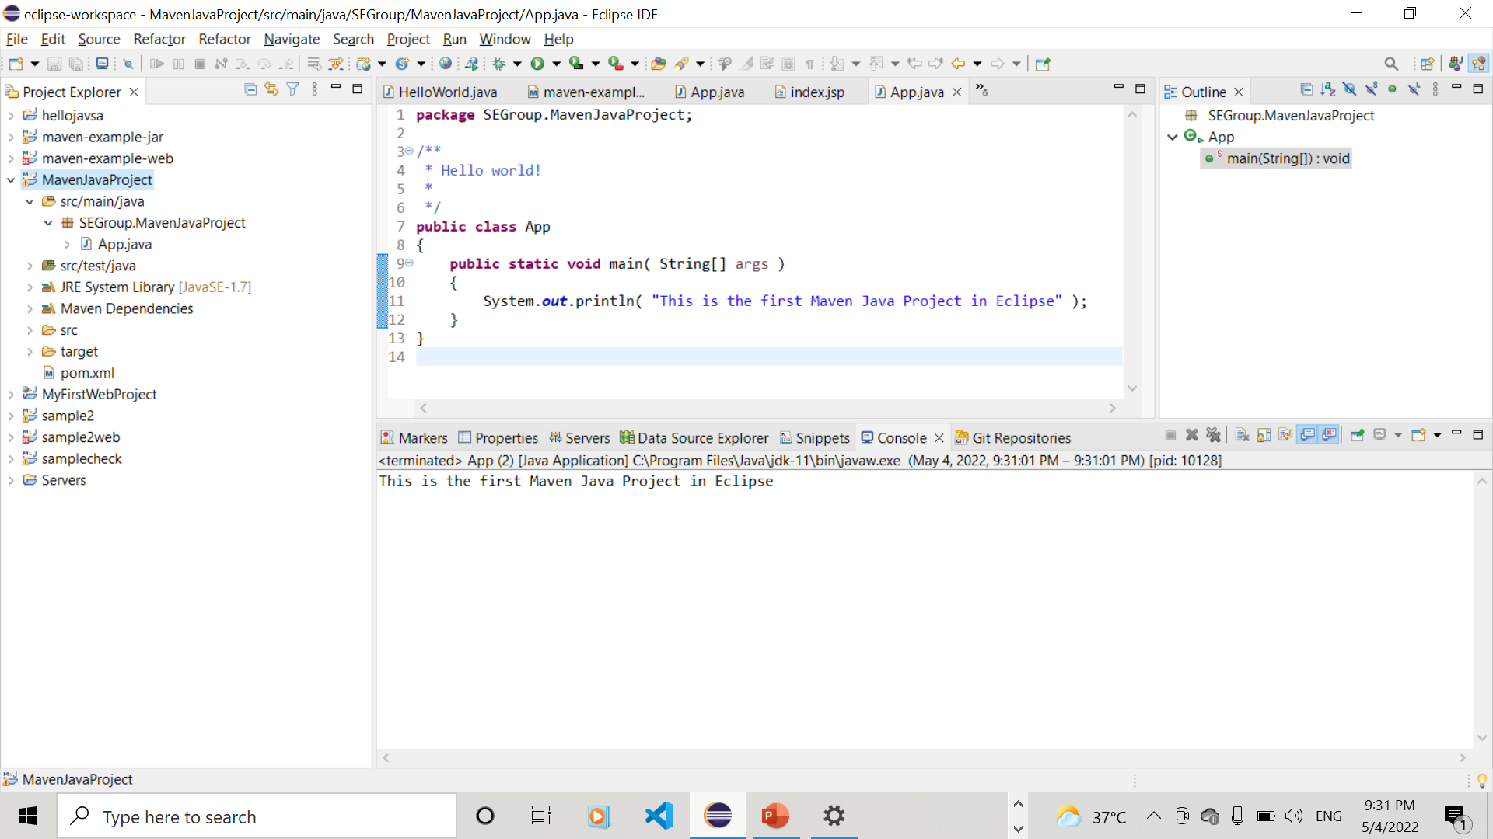
Step 18: The output “This is the first Java Project in Eclipse” is displayed

Slide 22
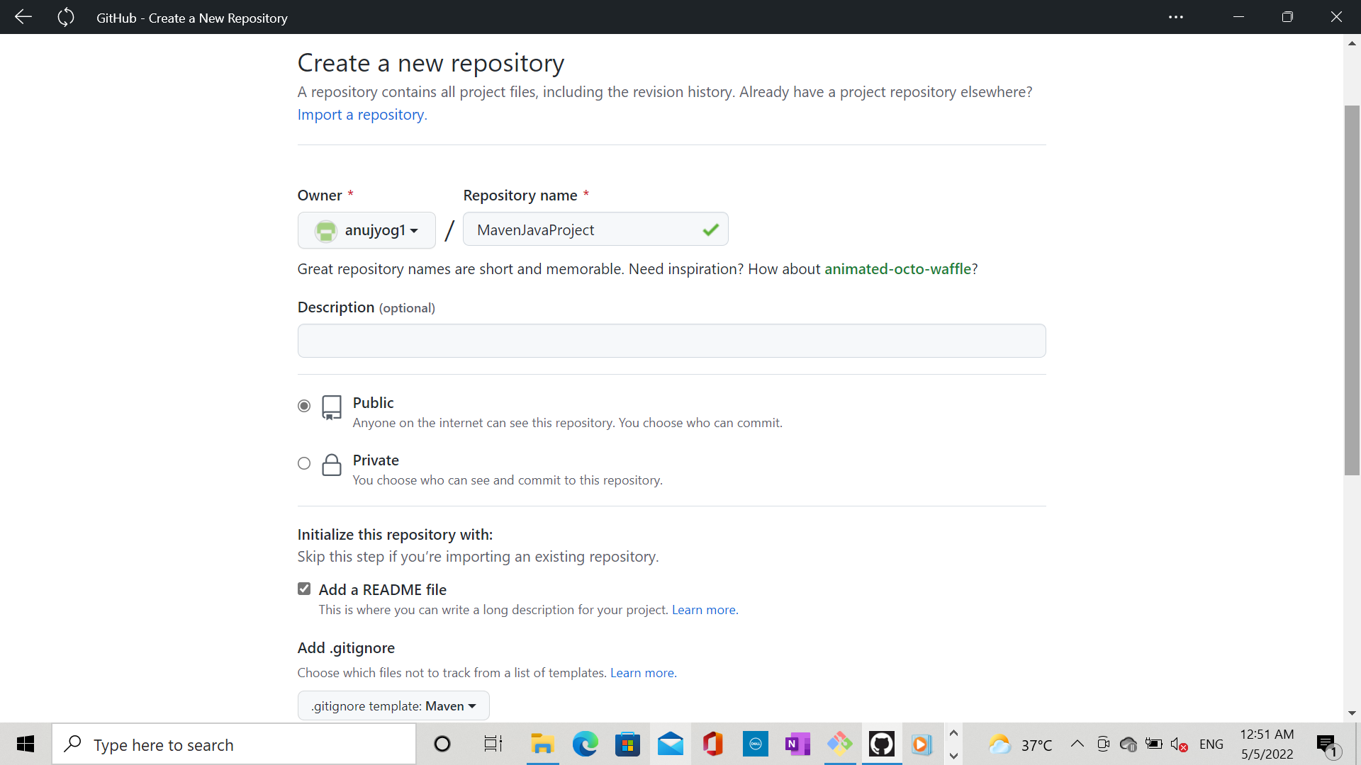
Step 19: Go to Github, and create an empty repository to get the Maven Java Project. Give Repository name = MavenJavaProject, select Public, tick on Add README , select gitignore template maven to ignore unwanted target files in maven project while committing

Slide 23
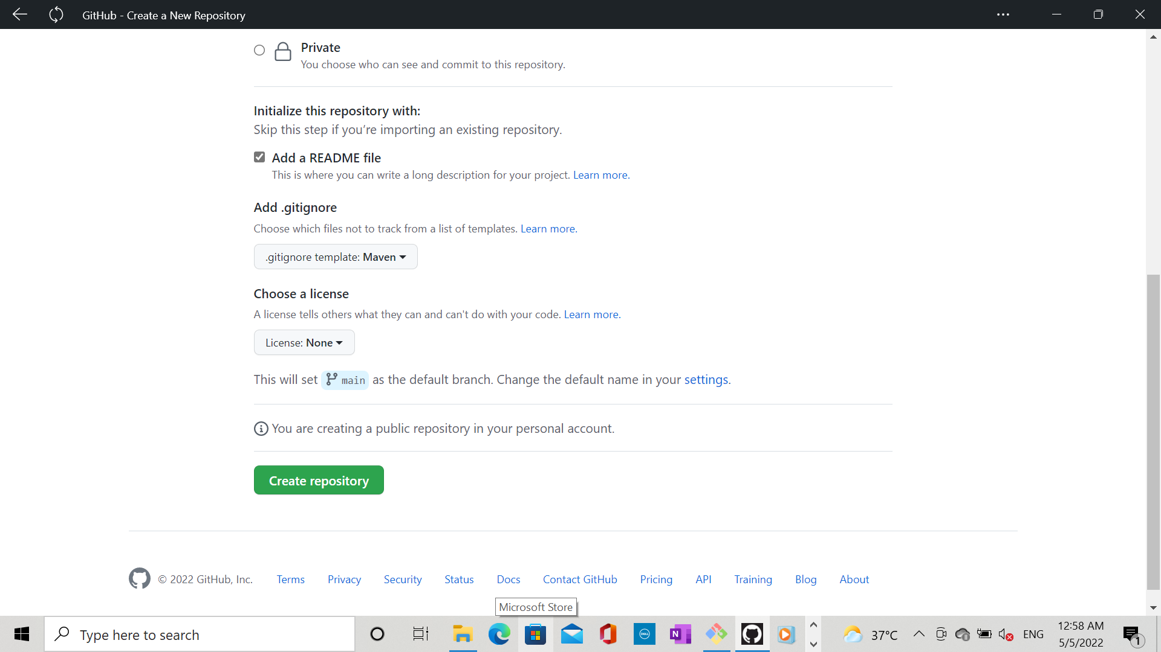
Step 20: Press on create repository

Slide 24
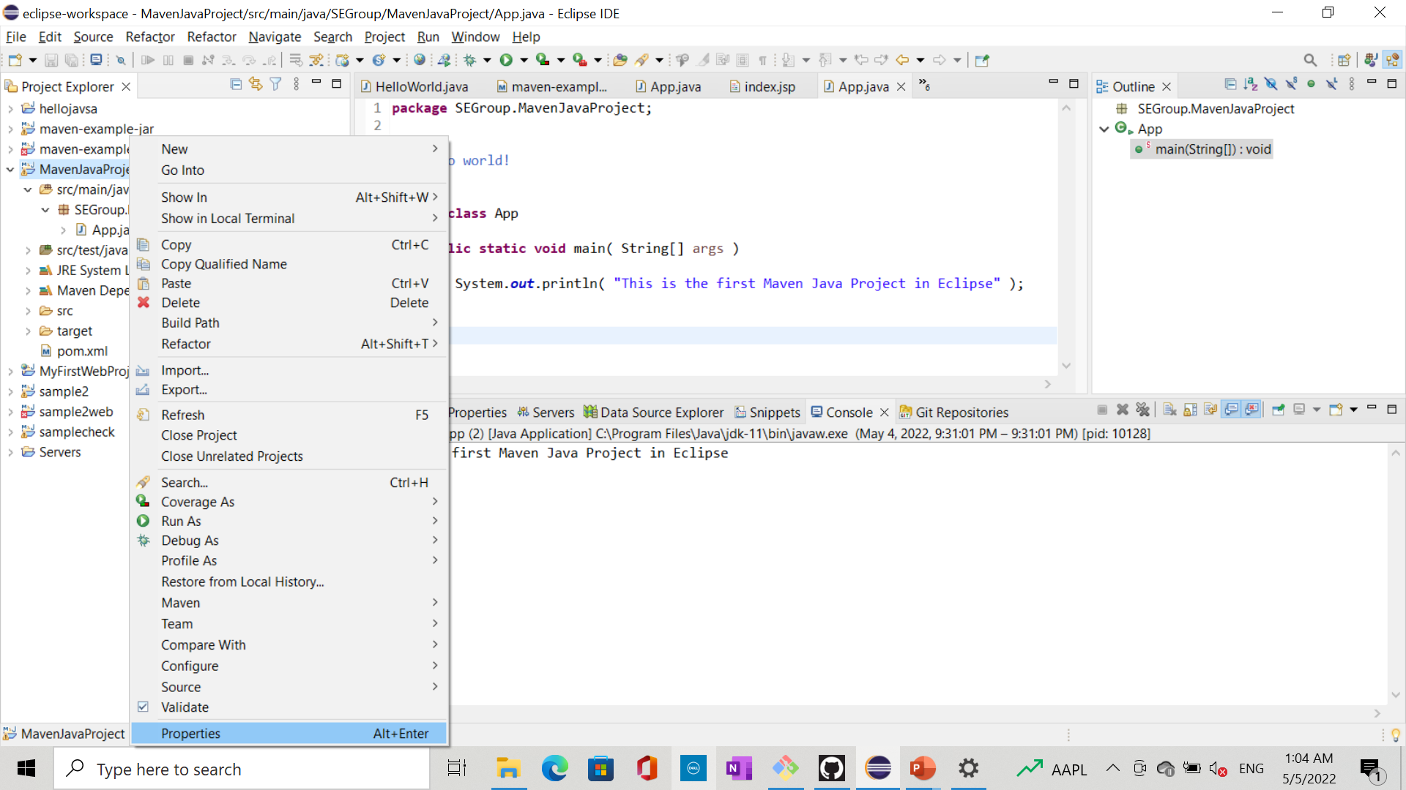
Step 21: Go to Eclipse, right-click on MavenJavaProject, Properties , Resources to get path

Slide 25
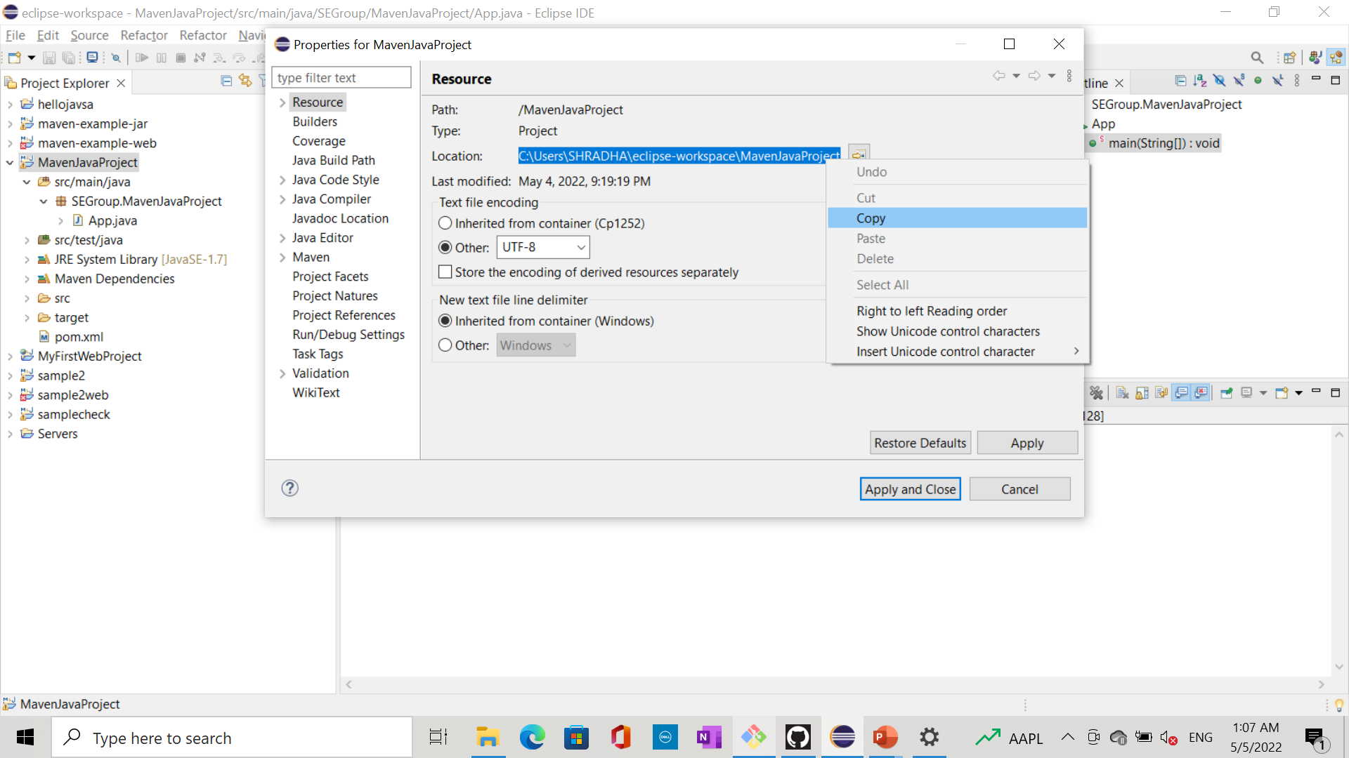
Step 22: copy the path of eclipse workspace

Slide 26
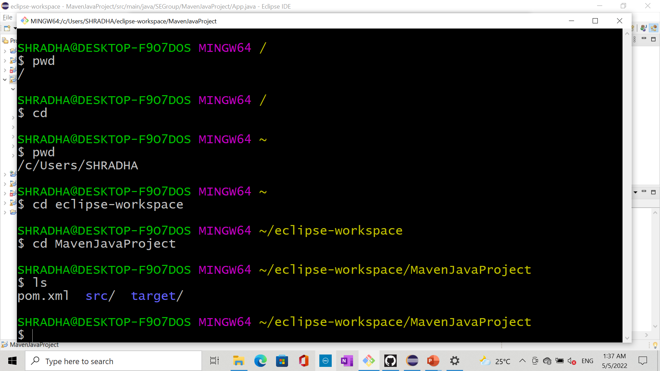
Step 23: Go to Git bash, and Change the directory to eclipse workspace, and then to MavenJavaProject. Next lt must show pom.xml

Slide 27
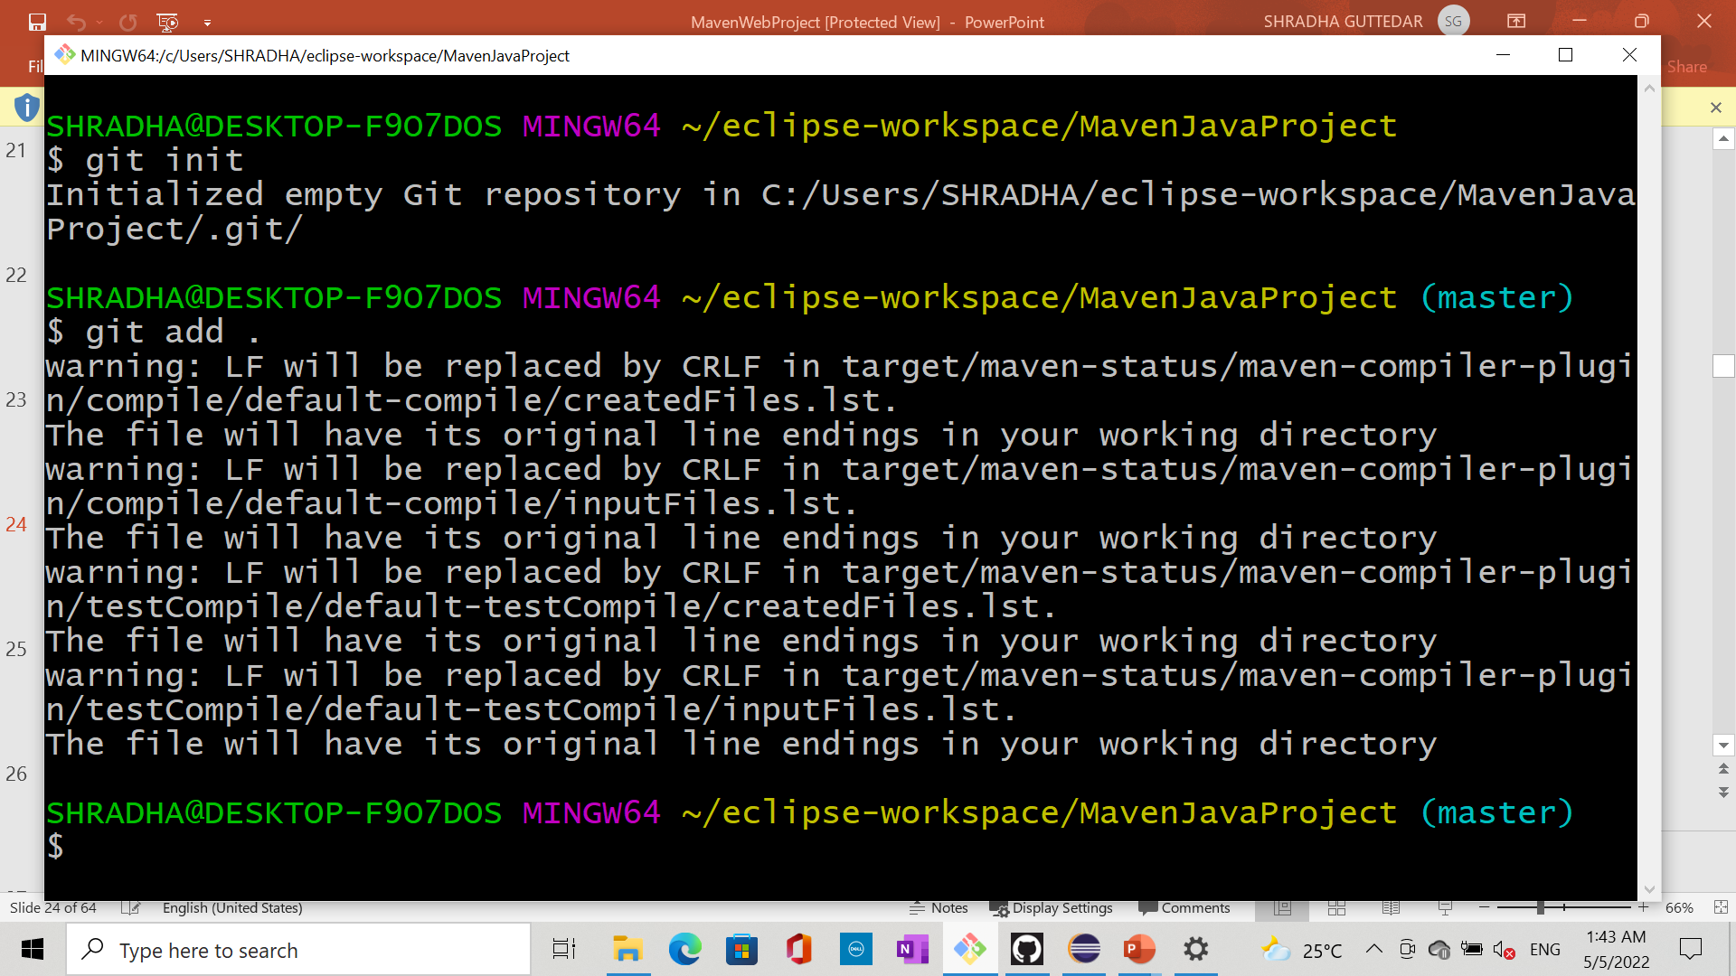
Step 24: git init and git add to initialize and add to local repository

Slide 28
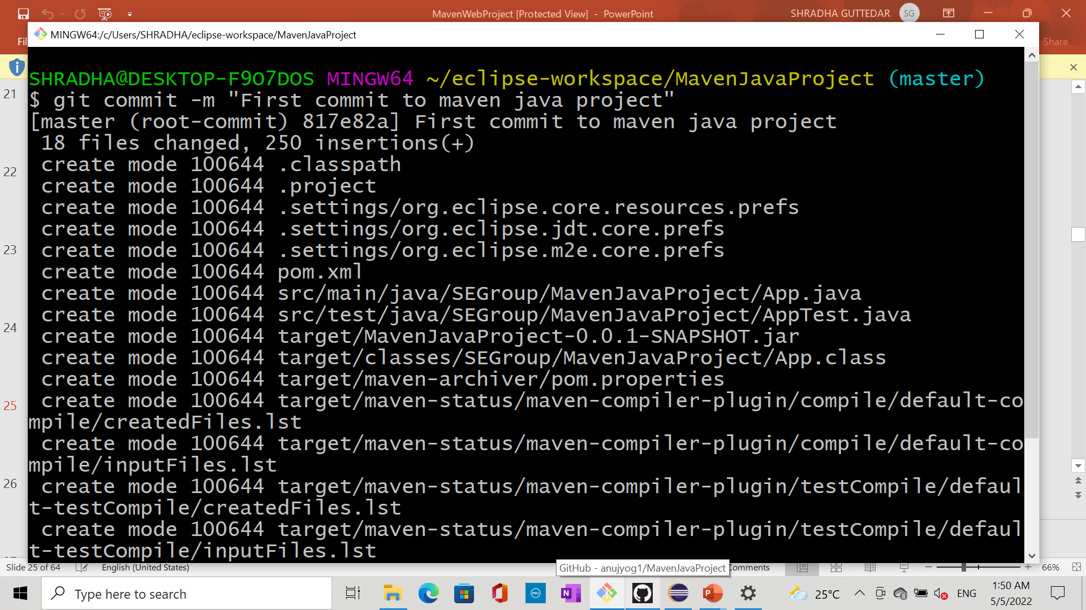
Step 25: git commit in local repository

Slide 29
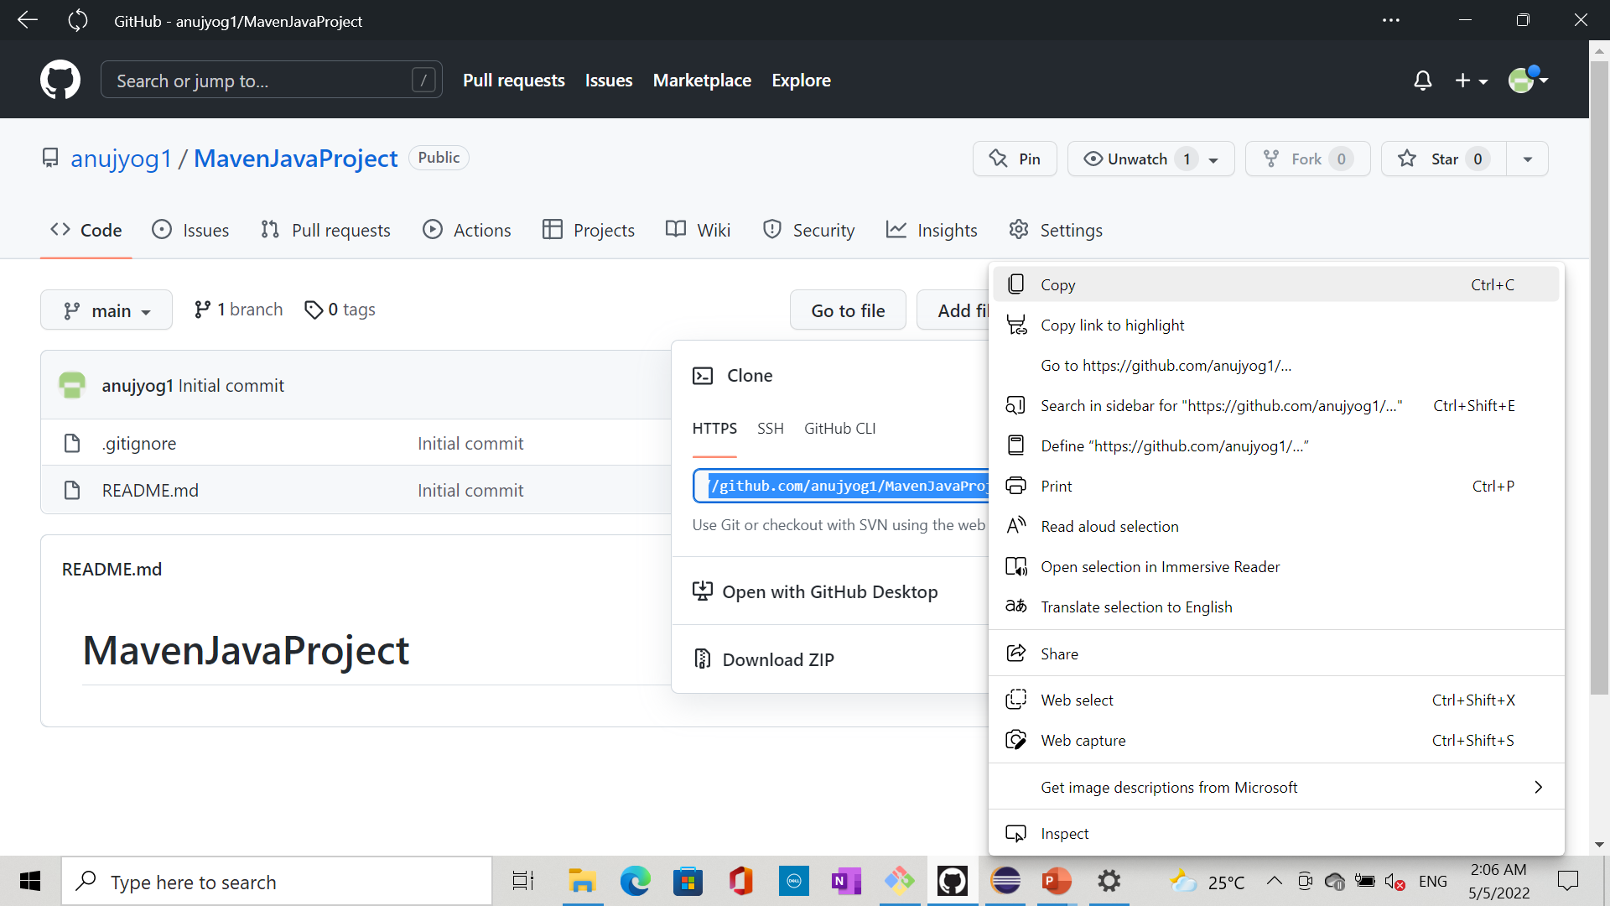
Step 26: Go to Git Hub and get remote repository path

Slide 30
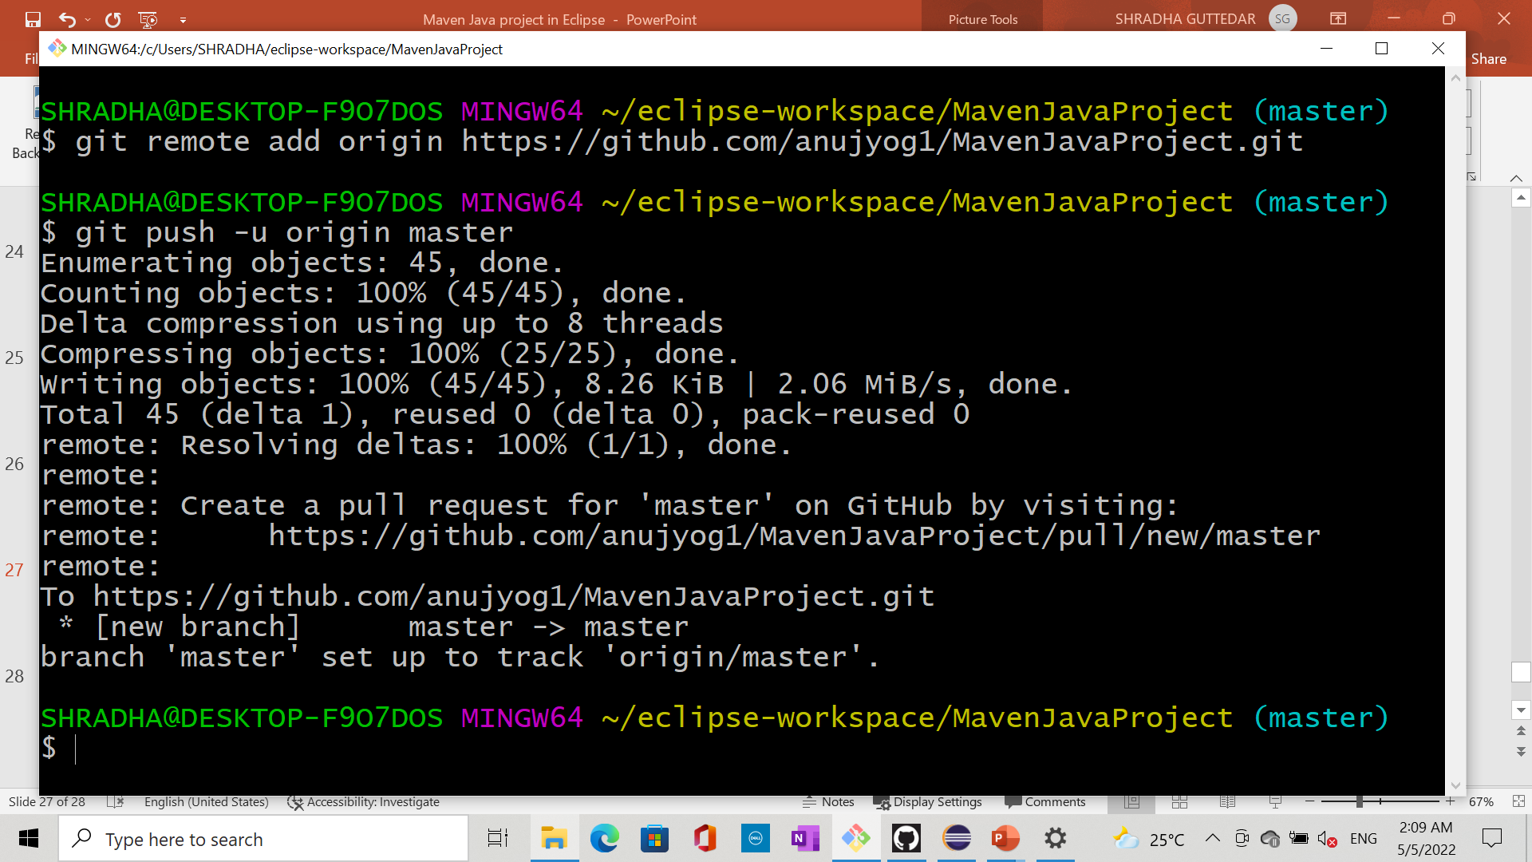
Step 27: get remote repository and push

Slide 31
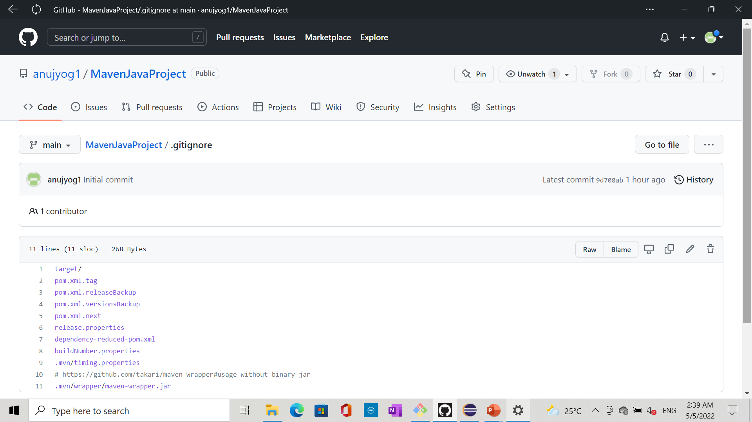
Step 28: Go to git Hub after pushing from git bash. Now refresh the git hub we see all the files are reflected here.

